Slide 1
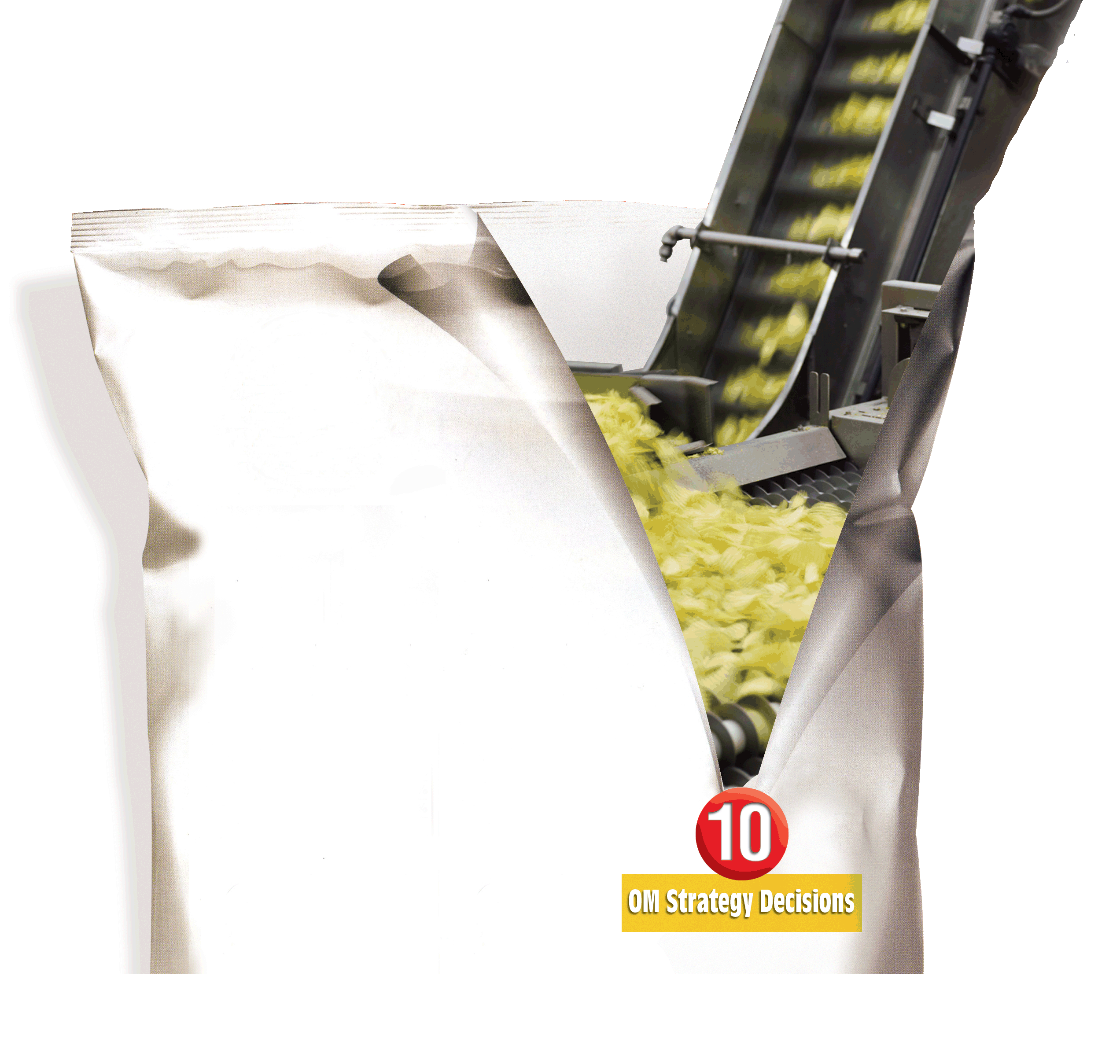
6
Managing Quality
PowerPoint presentation to accompany
Heizer and Render
Operations Management, 10e
Principles of Operations Management, 8e
PowerPoint slides by Jeff Heyl

Slide 2
Outline
Global Company Profile: Arnold Palmer Hospital
Quality and Strategy
Defining Quality
  Implications of Quality
  Malcolm Baldrige National Quality Award
  Cost of Quality (COQ)
  Ethics and Quality Management

Slide 3
Outline – Continued
International Quality Standards
  ISO 9000
  ISO14000

Slide 4
Outline – Continued
Total Quality Management
  Continuous Improvement
  Six Sigma
  Employee Empowerment
  Benchmarking
  Just-in-Time (JIT)
  Taguchi Concepts
  Knowledge of TQM Tools

Slide 5
Outline – Continued
Tools of TQM
  Check Sheets
  Scatter Diagrams
  Cause-and-Effect Diagrams
  Pareto Charts
  Flowcharts
  Histograms
  Statistical Process Control (SPC)

Slide 6
Outline – Continued
The Role of Inspection
  When and Where to Inspect
  Source Inspection
  Service Industry Inspection
  Inspection of Attributes versus Variables
TQM in Services

Slide 7
Learning Objectives
When you complete this chapter you should be able to:
Define quality and TQM
Describe the ISO international quality standards
Explain Six Sigma
Explain how benchmarking is used
Explain quality robust products and Taguchi concepts
Use the seven tools of TQM

Slide 8
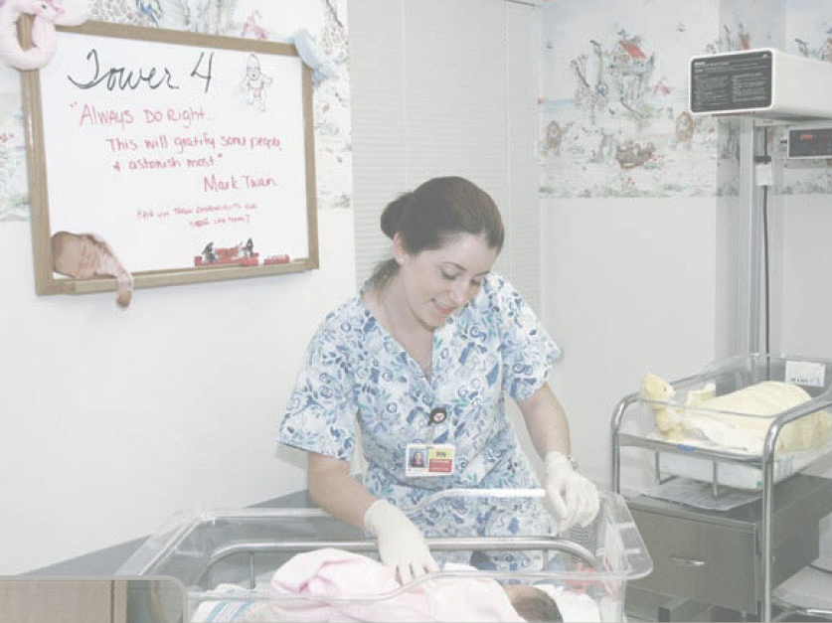
Managing Quality Provides a Competitive Advantage
Arnold Palmer Hospital
Deliver over 16,000 babies annually
Virtually every type of quality tool is employed
  Continuous improvement
  Employee empowerment
  Benchmarking
  Just-in-time
  Quality tools

Slide 9
Quality and Strategy
An operations manager’s objective is to build a total quality management system that identifies and satisfies customer needs

Slide 10
Quality and Strategy
Managing quality supports differentiation, low cost, and response strategies
Quality helps firms increase sales and reduce costs
Building a quality organization is a demanding task

Slide 11
Two Ways Quality
Improves Profitability
Sales Gains via
Improved response
Flexible pricing
Improved reputation
Improved Quality
Increased Profits
Reduced Costs via
Increased productivity
Lower rework and scrap costs
Lower warranty costs
Figure 6.1

Slide 12
The Flow of Activities
Organizational Practices
Leadership, Mission statement, Effective operating procedures, Staff support, Training
Yields: What is important and what is to be
accomplished
Quality Principles
Customer focus, Continuous improvement, Benchmarking, Just-in-time, Tools of TQM
Yields: How to do what is important and to be
accomplished
Employee Fulfillment
Empowerment, Organizational commitment
Yields: Employee attitudes that can accomplish
what is important
Customer Satisfaction
Winning orders, Repeat customers
Yields: An effective organization with
a competitive advantage
Figure 6.2

Slide 13
Defining Quality
The totality of features and characteristics of a product or service that bears on its ability to satisfy stated or implied needs
American Society for Quality

Slide 14
Different Views
User-based: better performance, more features
Manufacturing-based: conformance to standards, making it right the first time
Product-based: specific and measurable attributes of the product

Slide 15
Implications of Quality
Company reputation
  Perception of new products
  Employment practices
  Supplier relations
Product liability
  Reduce risk
Global implications
  Improved ability to compete

Slide 16
Key Dimensions of Quality
Performance
Features
Reliability
Conformance
Durability
Serviceability
Aesthetics
Perceived quality
Value
Notes:
7

Slide 17
Malcolm Baldrige National Quality Award
Established in 1988 by the U.S. government
Designed to promote TQM practices
Recent winners include
  Honeywell Federal, Midway USA, AtlantiCare, Heartland Health, Cargill Corn Milling, PRO-TEC Coating Co., City of Coral Springs, Premier Inc., Sunny Fresh Foods, Park Place Lexus, Richland College

Slide 18
Baldrige Criteria
Applicants are evaluated on:
Categories Points
Leadership 120
Strategic Planning 85
Customer & Market Focus 85
Measurement, Analysis, and Knowledge Management 90
Workforce Focus 85
Process Management 85
Results 450

Slide 19

Takumi
A Japanese character that symbolizes a broader dimension than quality, a deeper process than education, and a more perfect method than persistence

Slide 20
Costs of Quality
Prevention costs - reducing the potential for defects
Appraisal costs - evaluating products, parts, and services
Internal failure - producing defective parts or service before delivery
External costs - defects discovered after delivery

Slide 21
Costs of Quality
Total Cost
Total Cost
External Failure
Internal Failure
Prevention
Appraisal
Quality Improvement

Slide 22
Leaders in Quality
Leader Philosophy/Contribution
W. Edwards Deming 14 Points for Management
Joseph M. Juran Top management commitment, fitness for use
Armand Feigenbaum Total Quality Control
Philip B. Crosby Quality is Free, zero defects
Table 6.1

Slide 23
Ethics and Quality Management
Operations managers must deliver healthy, safe, quality products and services
Poor quality risks injuries, lawsuits, recalls, and regulation
Organizations are judged by how they respond to problems
All stakeholders much be considered

Slide 24
International Quality Standards
ISO 9000 series (Europe/EC)
  Common quality standards for products sold in Europe (even if made in U.S.)
  2008 update places greater emphasis on leadership and customer requirements and satisfaction
ISO 14000 series (Europe/EC)

Slide 25
ISO 14000
Environmental Standard
Core Elements:
Environmental management
Auditing
Performance evaluation
Labeling
Life cycle assessment

Slide 26
ISO 14000
Environmental Standard
Advantages:
Positive public image and reduced exposure to liability
Systematic approach to pollution prevention
Compliance with regulatory requirements and opportunities for competitive advantage
Reduction in multiple audits

Slide 27
TQM
Encompasses entire organization, from supplier to customer
Stresses a commitment by management to have a continuing, companywide drive toward excellence in all aspects of products and services that are important to the customer

Slide 28
Deming’s Fourteen Points
Create consistency of purpose
Lead to promote change
Build quality into the product; stop depending on inspections
Build long-term relationships based on performance instead of awarding business on price
Continuously improve product, quality, and service
Table 6.2

Slide 29
Deming’s Fourteen Points
Start training
Emphasize leadership
Drive out fear
Break down barriers between departments
Stop haranguing workers
Support, help, and improve
Table 6.2

Slide 30
Deming’s Fourteen Points
Remove barriers to pride in work
Institute education and self-improvement
Put everyone to work on the transformation
Table 6.2

Slide 31
Seven Concepts of TQM
Continuous improvement
Six Sigma
Employee empowerment
Benchmarking
Just-in-time (JIT)
Taguchi concepts
Knowledge of TQM tools

Slide 32
Continuous Improvement
Represents continual improvement of all processes
Involves all operations and work centers including suppliers and customers
  People, Equipment, Materials, Procedures

Slide 33
Shewhart’s PDCA Model
4. Act
Implement the plan document
Plan
Identify the pattern and make a plan
3. Check
Is the plan working?
2. Do
Test the plan
Figure 6.3

Slide 34
Six Sigma
Two meanings
  Statistical definition of a process that is 99.9997% capable, 3.4 defects per million opportunities (DPMO)
  A program designed to reduce defects, lower costs, and improve customer satisfaction

Slide 35
Six Sigma
Lower limits
Upper limits
Two meanings
  Statistical definition of a process that is 99.9997% capable, 3.4 defects per million opportunities (DPMO)
  A program designed to reduce defects, lower costs, and improve customer satisfaction
2,700 defects/million
3.4 defects/million
Mean
±3σ
±6σ
Figure 6.4

Slide 36
Six Sigma Program
Originally developed by Motorola, adopted and enhanced by Honeywell and GE
Highly structured approach to process improvement
  A strategy
  A discipline - DMAIC
6σ

Slide 37
Six Sigma
Define critical outputs
and identify gaps for improvement
Measure the work and
collect process data
Analyze the data
Improve the process
Control the new process to make sure new performance is maintained
DMAIC Approach

Slide 38
Six Sigma Implementation
Emphasize defects per million opportunities as a standard metric
Provide extensive training
Focus on corporate sponsor support (Champions)
Create qualified process improvement experts (Black Belts, Green Belts, etc.)
Set stretch objectives
This cannot be accomplished without a major commitment from top level management

Slide 39

Employee Empowerment
Getting employees involved in product and process improvements
  85% of quality problems are due
  to process and material
Techniques
  Build communication networks
  that include employees
  Develop open, supportive supervisors
  Move responsibility to employees
  Build a high-morale organization
  Create formal team structures

Slide 40
Quality Circles
Group of employees who meet regularly to solve problems
Trained in planning, problem solving, and statistical methods
Often led by a facilitator
Very effective when done properly

Slide 41
Benchmarking
Selecting best practices to use as a standard for performance
Use internal benchmarking if you’re big enough
Determine what to
benchmark
Form a benchmark team
Identify benchmarking partners
Collect and analyze benchmarking information
Take action to match or exceed the benchmark

Slide 42
Best Practices for Resolving Customer Complaints
Best Practice |  | Justification
Make it easy for clients to complain |  | It is free market research
Respond quickly to complaints |  | It adds customers and loyalty
Resolve complaints on first contact |  | It reduces cost
Use computers to manage complaints |  | Discover trends, share them, and align your services
Recruit the best for customer service jobs |  | It should be part of formal training and career advancement
Table 6.3

Slide 43
Just-in-Time (JIT)
Relationship to quality:
JIT cuts the cost of quality
JIT improves quality
Better quality means less inventory and better, easier-to-employ JIT system

Slide 44
Just-in-Time (JIT)
‘Pull’ system of production scheduling including supply management
  Production only when signaled
Allows reduced inventory levels
  Inventory costs money and hides process and material problems
Encourages improved process and product quality

Slide 45
Just-In-Time (JIT) Example
Work in process inventory level
(hides problems)
Unreliable Vendors
Capacity Imbalances
Scrap

Slide 46
Just-In-Time (JIT) Example
Reducing inventory reveals
problems so they can be solved
Unreliable Vendors
Capacity Imbalances
Scrap

Slide 47
Taguchi Concepts
Engineering and experimental design methods to improve product and process design
  Identify key component and process variables affecting product variation
Taguchi Concepts
  Quality robustness
  Quality loss function
  Target-oriented quality

Slide 48
Quality Robustness
Ability to produce products uniformly in adverse manufacturing and environmental conditions
  Remove the effects of adverse conditions
  Small variations in materials and process do not destroy product quality

Slide 49
Quality Loss Function
Shows that costs increase as the product moves away from what the customer wants
Costs include customer dissatisfaction, warranty
and service, internal
scrap and repair, and costs to society
Traditional conformance specifications are too simplistic
Target-oriented quality

Slide 50
Quality Loss Function
High loss
L = D²C
Unacceptable
where
L = loss to society
D = distance from target value
C = cost of deviation
Loss (to producing organization, customer, and society)
Poor
Fair
Good
Low loss
Best
Target-oriented quality yields more product in the “best” category
Target-oriented quality brings product toward the target value
Frequency
Conformance-oriented quality keeps products within 3 standard deviations
Lower
Target
Upper
Specification
Figure 6.5

Slide 51
Tools of TQM
Tools for Generating Ideas
  Check sheets
  Scatter diagrams
  Cause-and-effect diagrams
Tools to Organize the Data
  Pareto charts
  Flowcharts

Slide 52
Tools of TQM
Tools for Identifying Problems
  Histogram
  Statistical process control chart

Slide 53
Seven Tools of TQM
(a) Check Sheet: An organized method of recording data
/ / /// /
// ///
// ////
///
//
/
/
/
//
/
/
/
Hour
Defect 1 2 3 4 5 6 7 8
A
B
C
Figure 6.6

Slide 54
Seven Tools of TQM
(b) Scatter Diagram: A graph of the value of one variable vs. another variable
Productivity
Absenteeism
Figure 6.6

Slide 55
Seven Tools of TQM
(c) Cause-and-Effect Diagram: A tool that identifies process elements (causes) that might effect an outcome
Cause
Materials
Methods
Effect
Manpower
Machinery
Figure 6.6

Slide 56
Seven Tools of TQM
(d) Pareto Chart: A graph to identify and plot problems or defects in descending order of frequency
Frequency
Percent
A B C D E
Figure 6.6

Slide 57
Seven Tools of TQM
(e) Flowchart (Process Diagram): A chart that describes the steps in a process
Figure 6.6

Slide 58
Seven Tools of TQM
(f) Histogram: A distribution showing the frequency of occurrences of a variable
Distribution
Frequency
Repair time (minutes)
Figure 6.6

Slide 59
Seven Tools of TQM
(g) Statistical Process Control Chart: A chart with time on the horizontal axis to plot values of a statistic
Upper control limit
Target value
Lower control limit
Time
Figure 6.6

Slide 60
Cause-and-Effect Diagrams
Material
(ball)
Method
(shooting process)
Grain/Feel (grip)
Aiming point
Size of ball
Bend knees
Air pressure
Hand position
Lopsidedness
Balance
Follow-through
Missed
free-throws
Training
Rim size
Conditioning
Motivation
Rim height
Consistency
Rim alignment
Backboard stability
Concentration
Manpower
(shooter)
Machine
(hoop &
backboard)
Figure 6.7

Slide 61
Pareto Charts
Data for October
70 –
60 –
50 –
40 –
30 –
20 –
10 –
0 –
– 100
– 93
– 88
– 72
54
Frequency (number)
Number of occurrences
Cumulative percent
12
4
3
2
Room svc Check-in Pool hours Minibar Misc.
72% 16% 5% 4% 3%
Causes and percent of the total

Slide 62
Flow Charts
MRI Flowchart
Physician schedules MRI
Patient taken to MRI
Patient signs in
Patient is prepped
Technician carries out MRI
Technician inspects film
If unsatisfactory, repeat
Patient taken back to room
MRI read by radiologist
MRI report transferred to physician
Patient and physician discuss
8
80%
1
2
3
4
5
6
7
11
9
10
20%

Slide 63
Statistical Process Control (SPC)
Uses statistics and control charts to tell when to take corrective action
Drives process improvement
Four key steps
  Measure the process
  When a change is indicated, find the assignable cause
  Eliminate or incorporate the cause
  Restart the revised process

Slide 64
An SPC Chart
Plots the percent of free throws missed
20%
10%
0%
Upper control limit
Coach’s target value
| | | | | | | | |
1 2 3 4 5 6 7 8 9
Lower control limit
Game number
Figure 6.8

Slide 65
Inspection
Involves examining items to see if an item is good or defective
Detect a defective product
  Does not correct deficiencies in process or product
  It is expensive
Issues
  When to inspect
  Where in process to inspect

Slide 66
When and Where to Inspect
At the supplier’s plant while the supplier is producing
At your facility upon receipt of goods from the supplier
Before costly or irreversible processes
During the step-by-step production process
When production or service is complete
Before delivery to your customer
At the point of customer contact

Slide 67
Inspection
Many problems
  Worker fatigue
  Measurement error
  Process variability
Cannot inspect quality into a product
Robust design, empowered employees, and sound processes are better solutions

Slide 68
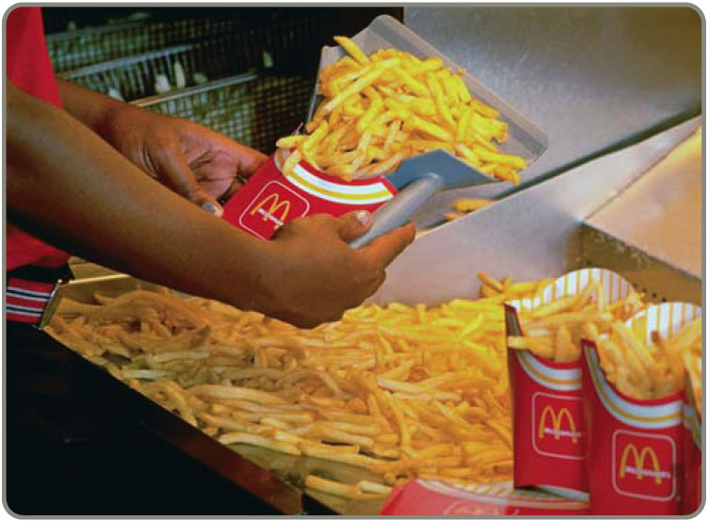
Source Inspection
Also known as source control
The next step in the process is your customer
Ensure perfect product
to your customer
Poka-yoke is the concept of foolproof devices or techniques designed to pass only acceptable product

Slide 69
Service Industry Inspection
Organization | What is Inspected | Standard
Jones Law Office | Receptionist performance Billing Attorney | Is phone answered by the second ring Accurate, timely, and correct format Promptness in returning calls
Table 6.4

Slide 70
Service Industry Inspection
Organization | What is Inspected | Standard
Hard Rock Hotel | Reception desk Doorman Room Minibar | Use customer’s name Greet guest in less than 30 seconds All lights working, spotless bathroom Restocked and charges accurately posted to bill
Table 6.4

Slide 71
Service Industry Inspection
Organization | What is Inspected | Standard
Arnold Palmer Hospital | Billing Pharmacy Lab Nurses Admissions | Accurate, timely, and correct format Prescription accuracy, inventory accuracy Audit for lab-test accuracy Charts immediately updated Data entered correctly and completely
Table 6.4

Slide 72
Service Industry Inspection
Organization | What is Inspected | Standard
Olive Garden Restaurant | Busboy Busboy Waiter | Serves water and bread within 1 minute Clears all entrée items and crumbs prior to dessert Knows and suggest specials, desserts
Table 6.4

Slide 73
Service Industry Inspection
Organization | What is Inspected | Standard
Nordstrom Department Store | Display areas Stockrooms Salesclerks | Attractive, well-organized, stocked, good lighting Rotation of goods, organized, clean Neat, courteous, very knowledgeable
Table 6.4

Slide 74
Attributes Versus Variables
Attributes
  Items are either good or bad, acceptable or unacceptable
  Does not address degree of failure
Variables
  Measures dimensions such as weight, speed, height, or strength
  Falls within an acceptable range
Use different statistical techniques

Slide 75
TQM In Services
Service quality is more difficult to measure than the quality of goods
Service quality perceptions depend on
  Intangible differences between products
  Intangible expectations customers have of those products

Slide 76
Service Quality
The Operations Manager must recognize:
The tangible component of services is important
The service process is important
The service is judged against the customer’s expectations
Exceptions will occur

Slide 77
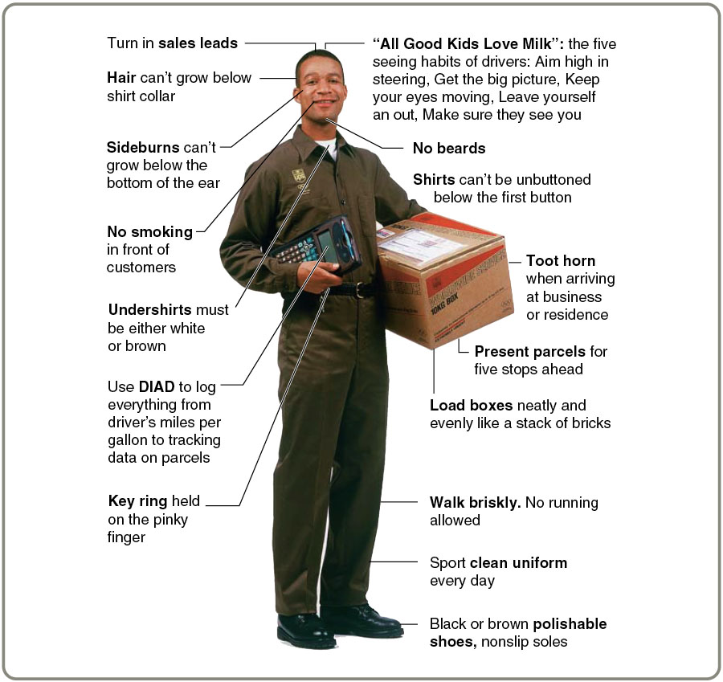
Service
Specifications at UPS

Slide 78
Determinants of Service Quality
Reliability | Consistency of performance and dependability
Responsiveness | Willingness or readiness of employees
Competence | Required skills and knowledge
Access | Approachability and ease of contact
Courtesy | Politeness, respect, consideration, friendliness
Communication | Keeping customers informed
Credibility | Trustworthiness, believability, honesty
Security | Freedom from danger, risk, or doubt
Understanding/ knowing the customer | Understand the customer’s needs
Tangibles | Physical evidence of the service
Table 6.5

Slide 79
Service Recovery Strategy
Managers should have a plan for when services fail
Marriott’s LEARN routine
  Listen
  Empathize
  Apologize
  React
  Notify

Slide 80

All rights reserved. No part of this publication may be reproduced, stored in a retrieval system, or transmitted, in any form or by any means, electronic, mechanical, photocopying, recording, or otherwise, without the prior written permission of the publisher.
Printed in the United States of America.

